Slide 1
Spanish culture, food and traditions
ñ
SEVILLANAS
TAPAS
SANGRIA
SOL Y PLAYA
FIESTA
ACEITE DE OLIVA
VINO
SIESTA
JAMON
TORTILLA

Slide 2
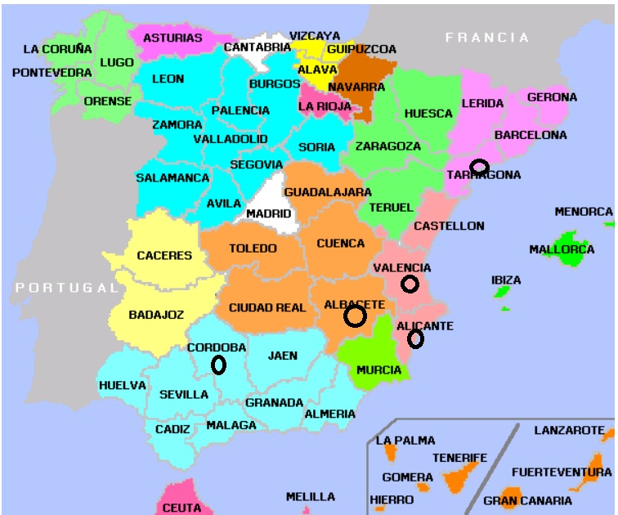
Spain

Slide 3
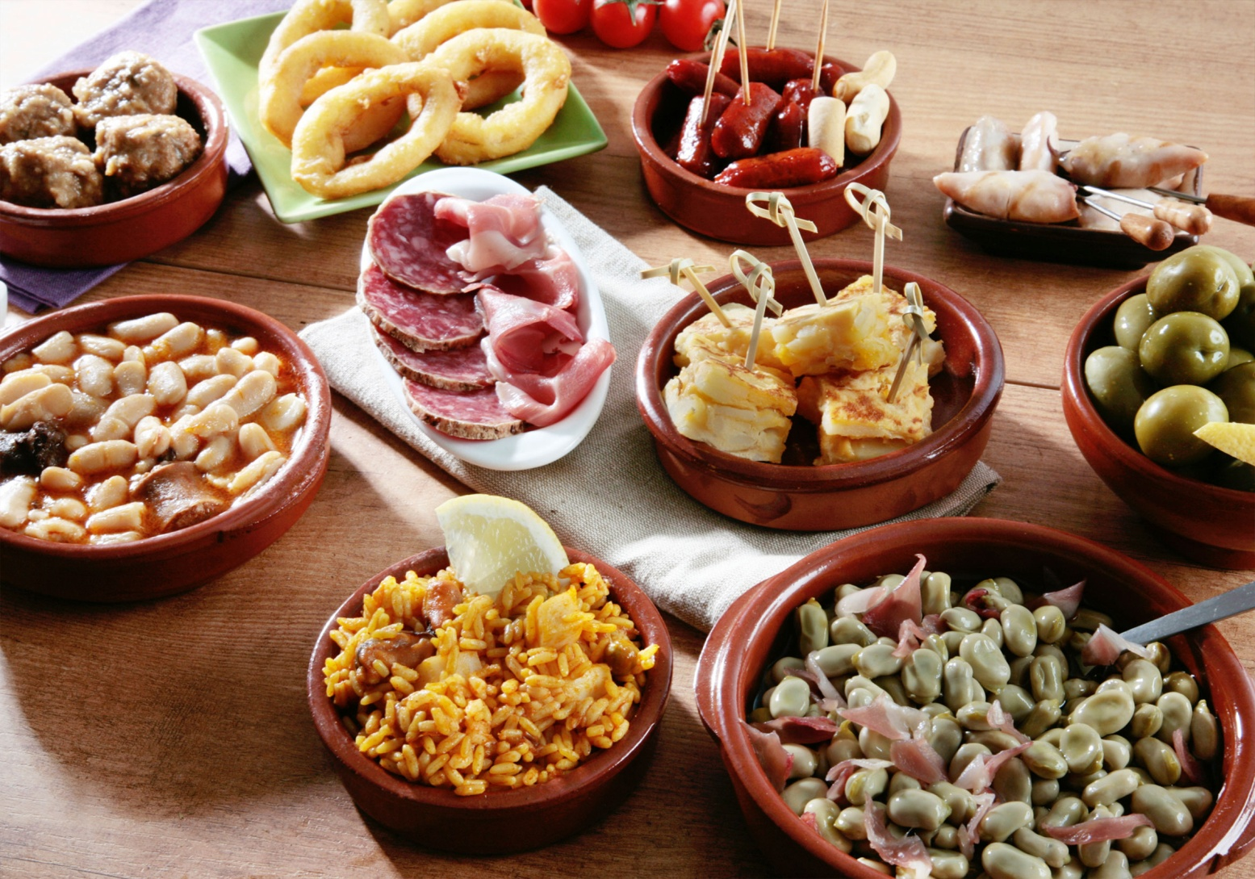
Spanish Tapas!

Slide 4
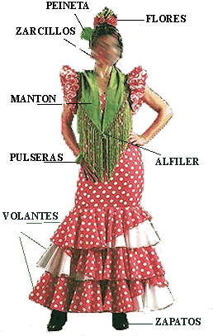
Gitana’s dress

